Slide 1


Cissey BELLO
28/11/2025

Slide 2

Outline
Executive Summary
Introduction
Methodology
Results
Conclusion
Appendix

Slide 3
Executive Summary
Summary of methodologies
Summary of all results

Slide 4
Introduction
Project background and context
Problems you want to find answers

Slide 5

Section 1

Slide 6
Methodology
Executive Summary
Data collection methodology:
Data was collected Using the SpaceX API and Web Scraping Launch Records from Wikipedia
Perform data wrangling
Data wrangling was performed by loading the raw dataset, identifying missing values, categorizing feature and analyzing outcome patterns
Perform exploratory data analysis (EDA) using visualization and SQL
Perform interactive visual analytics using Folium and Plotly Dash
Perform predictive analysis using classification models
How to build, tune, evaluate classification models

Slide 7
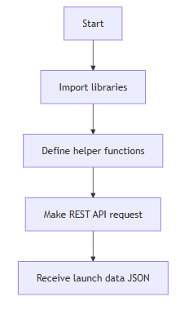
Data Collection – SpaceX API
To see SpaceX API notebook (GitHub) click here Link
Set up environment for REST API communication and data processing
Prepare functions for extracting detailed rocket, payload, launch site, and core information via REST calls
Request bulk launch records from SpaceX API
Convert API response to pandas DataFrame for data manipulation

Slide 8
Data Collection - Scraping
To see Web scraping notebook (GitHub) click here Link
Import libraries
Target the URL & GET request
Extract the target Data
Save
Parse
Set up environment for scraping communication and data processing
Target the Wikipedia URL and Make HTTP GET request (simulate browser)
Parse returned HTML for tables
Extract headers and initialize storage, Iterate over rows, clean and parse values
Store results and convert to DataFrame

Slide 9
Data Wrangling
To see Web Wrangling notebook (GitHub) click here Link
Summary of Data Wrangling Process (SpaceX Falcon 9 Dataset)
Installed and imported required libraries (pandas, numpy) for data processing.
Loaded the raw dataset using Pandas and previewed its structure.
Checked for and calculated missing values in every feature to assess data completeness.
Classified columns into categorical and numerical types for targeted analysis.
Explored launch sites and orbit types using value counts to understand their distributions.
Examined landing outcomes, categorizing them as "successful" or "unsuccessful."
Created a binary label (Class) for each launch: 1 for successful landings and 0 for failures.

Slide 10
EDA with Data Visualization
To see EDA with Data Visualization notebook (GitHub) click here Link
Summarize what charts were plotted and why you used those charts
Add the GitHub URL of your completed EDA with data visualization notebook, as an external reference and peer-review purpose

Slide 11
EDA with SQL
To see EDA with SQL notebook (GitHub) click here Link
Using bullet point format, summarize the SQL queries you performed
Add the GitHub URL of your completed EDA with SQL notebook, as an external reference and peer-review purpose

Slide 12
Build an Interactive Map with Folium
To see Interactive Map with Folium notebook (GitHub) click here Link
Summarize what map objects such as markers, circles, lines, etc. you created and added to a folium map
Explain why you added those objects
Add the GitHub URL of your completed interactive map with Folium map, as an external reference and peer-review purpose

Slide 13
Build a Dashboard with Plotly Dash
To see Dashboard with Plotly Dash (GitHub) click here Link
Summarize what plots/graphs and interactions you have added to a dashboard
Explain why you added those plots and interactions
Add the GitHub URL of your completed Plotly Dash lab, as an external reference and peer-review purpose

Slide 14
Predictive Analysis (Classification)
To see Predictive Analysis notebook (GitHub) click here Link
Summarize how you built, evaluated, improved, and found the best performing classification model
You need present your model development process using key phrases and flowchart
Add the GitHub URL of your completed predictive analysis lab, as an external reference and peer-review purpose

Slide 15
Results
Exploratory data analysis results
Interactive analytics demo in screenshots
Predictive analysis results

Slide 16

Section 2

Slide 17
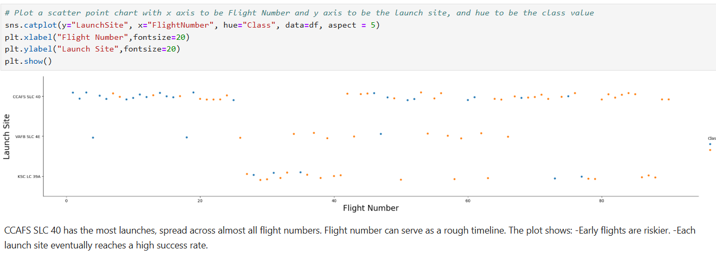
Flight Number vs. Launch Site

Slide 18
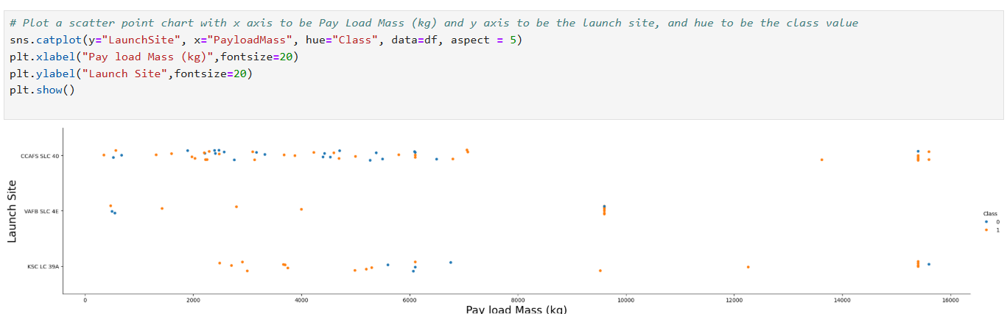
Payload vs. Launch Site

Slide 19
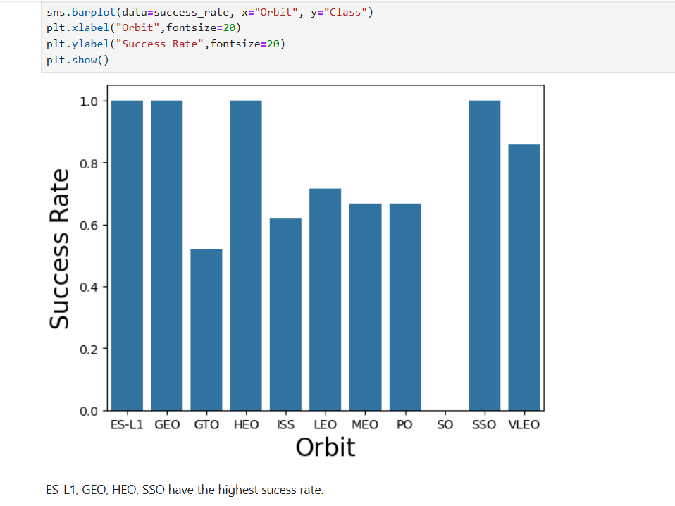
Success Rate vs. Orbit Type

Slide 20
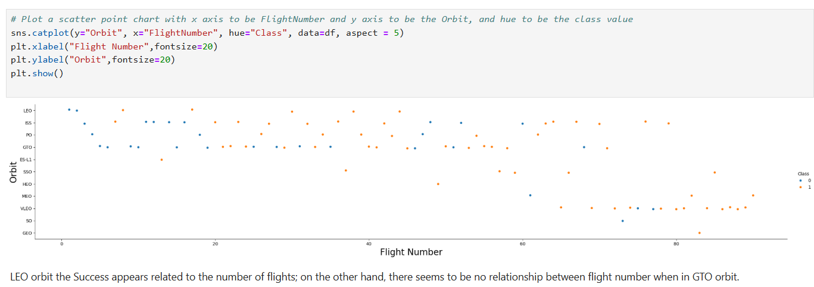
Flight Number vs. Orbit Type

Slide 21
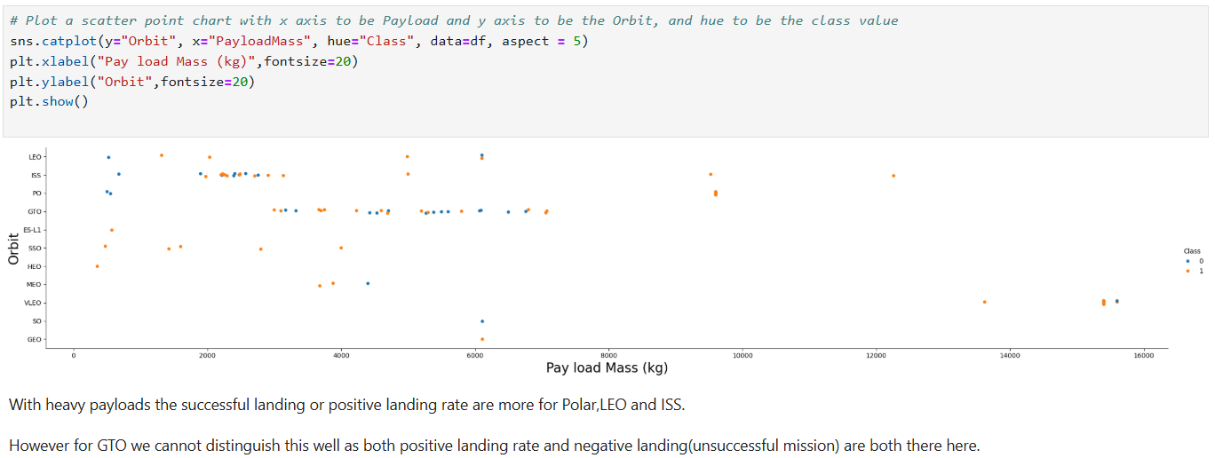
Payload vs. Orbit Type

Slide 22
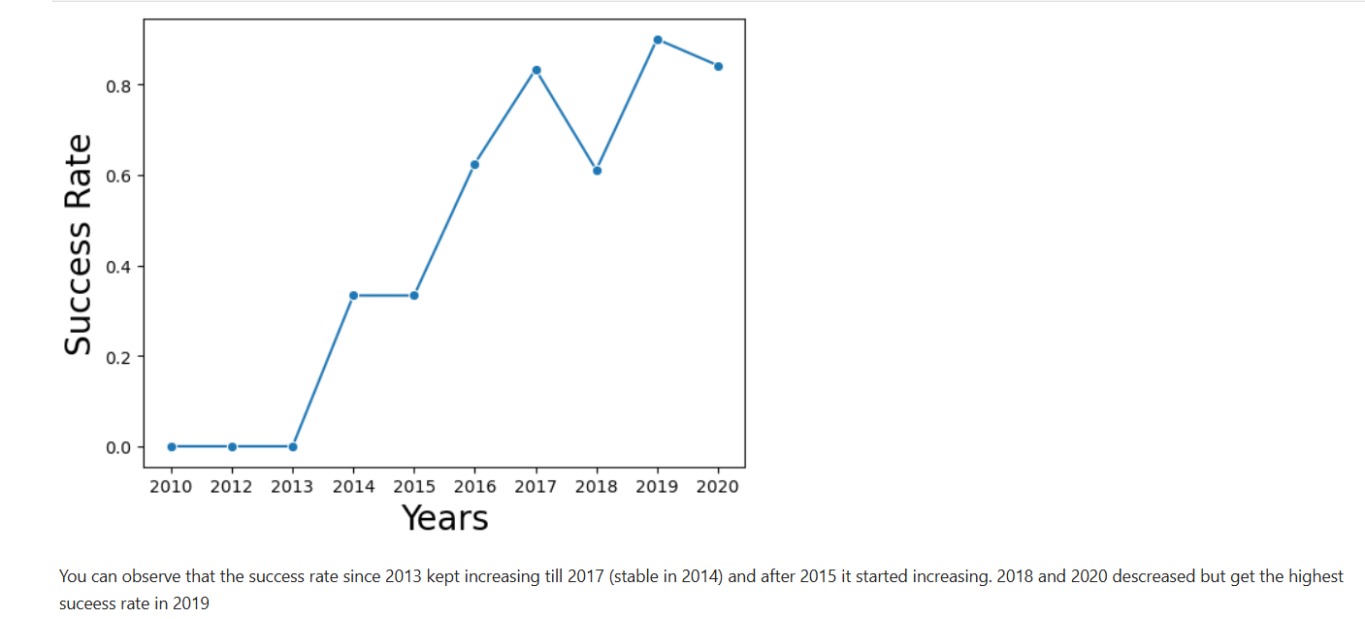
Launch Success Yearly Trend

Slide 23
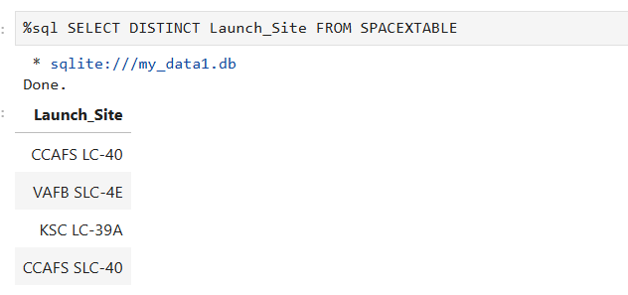
All Launch Site Names
Distinct allow to retrieve unique Launch Site in The SPACEX Table

Slide 24
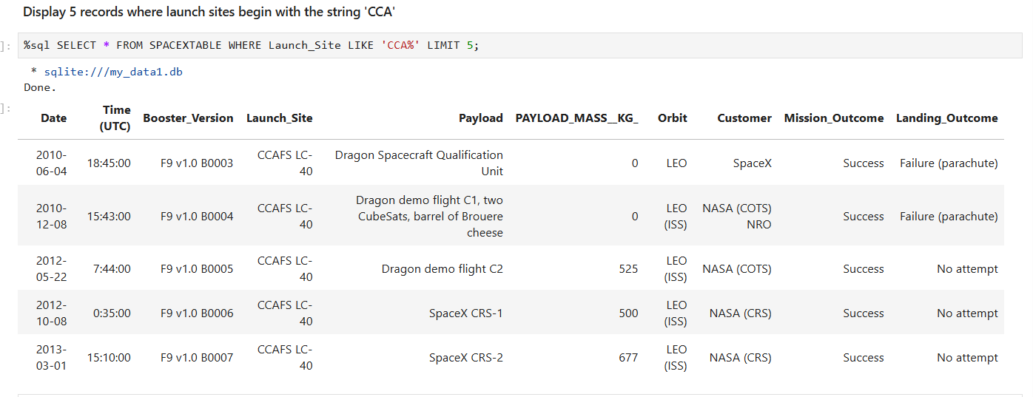
Launch Site Names Begin with 'CCA'

Slide 25
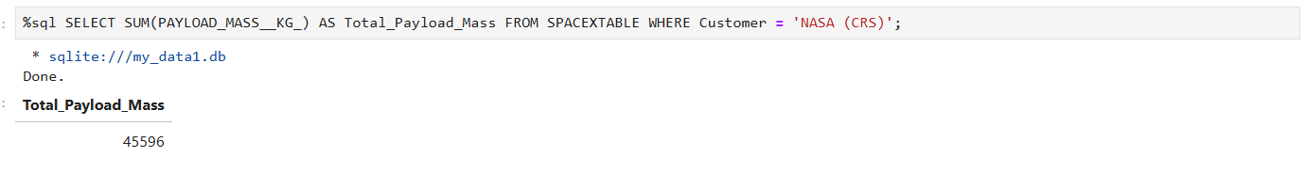
Total Payload Mass
Summarize the total payload Mass carried by boosters from NASA
To get the result use the function SUM and filter with customer = `NASA (CRS)´

Slide 26
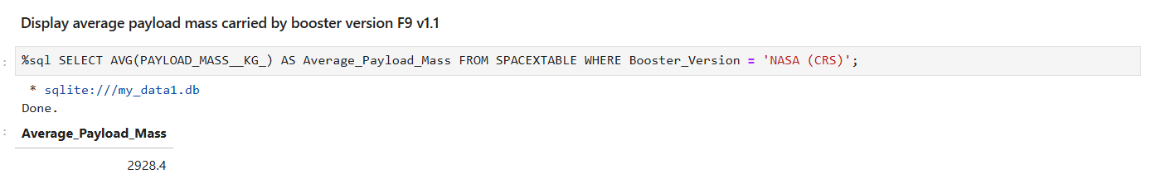
Average Payload Mass by F9 v1.1

Slide 27
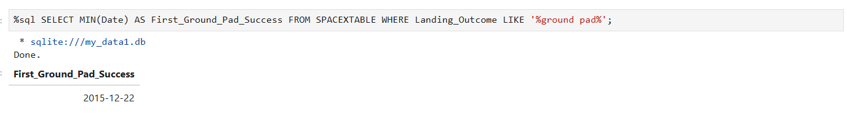
First Successful Ground Landing Date

Slide 28
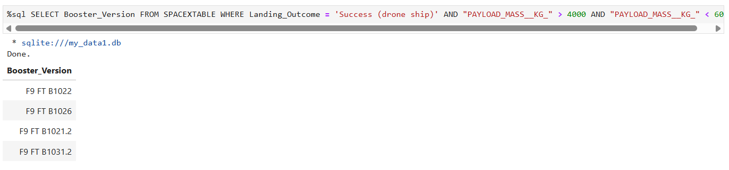
Successful Drone Ship Landing with Payload between 4000 and 6000
List the names of boosters which have successfully landed on drone ship and had payload mass greater than 4000 but less than 6000

Slide 29
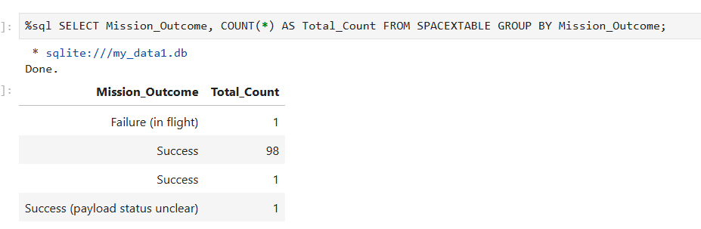
Total Number of Successful and Failure Mission Outcomes
Calculate the total number of successful and failure mission outcomes

Slide 30
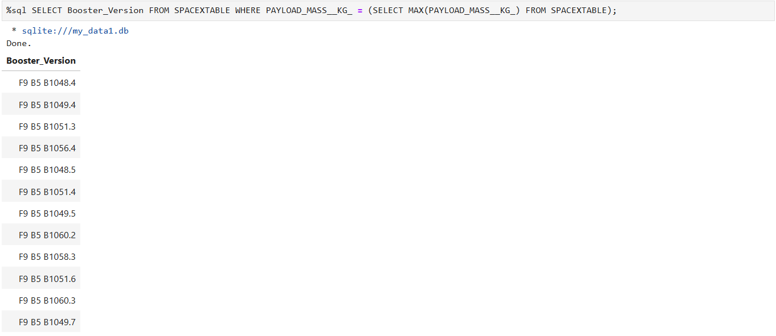
Boosters Carried Maximum Payload
List the names of the booster which have carried the maximum payload mass

Slide 31
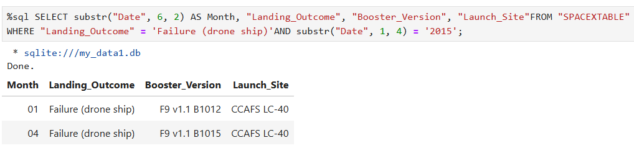
2015 Launch Records
List the failed landing_outcomes in drone ship, their booster versions, and launch site names for in year 2015

Slide 32
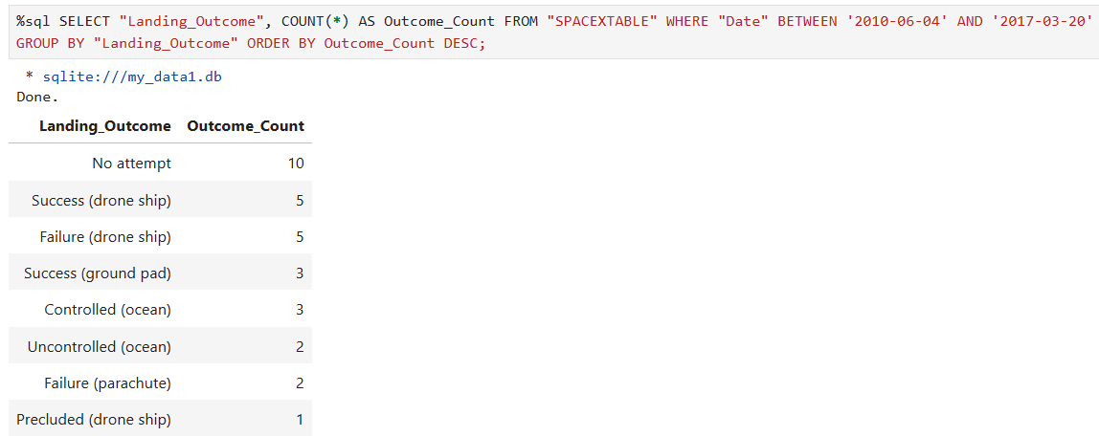
Rank Landing Outcomes Between 2010-06-04 and 2017-03-20
Rank the count of landing outcomes (such as Failure (drone ship) or Success (ground pad)) between the date 2010-06-04 and 2017-03-20, in descending order

Slide 33

Section 3

Slide 34
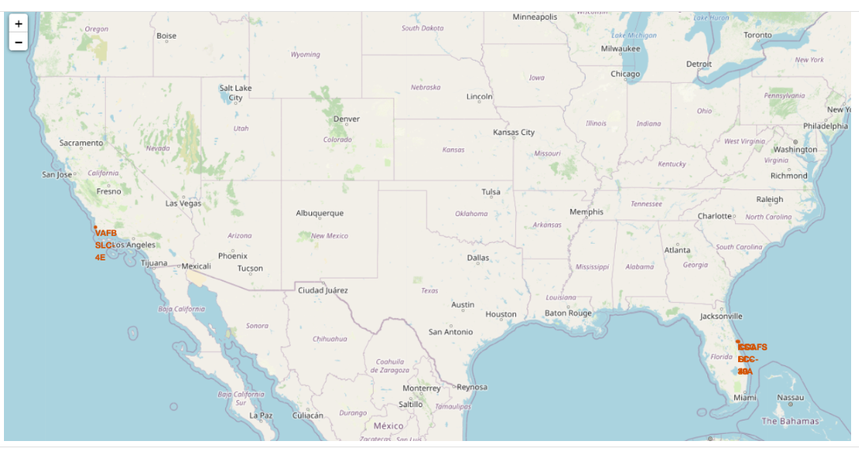
Launch sites 'location
Only VAFB SLC-4E site is on the west coast of US. The rest is on the East coast

Slide 35
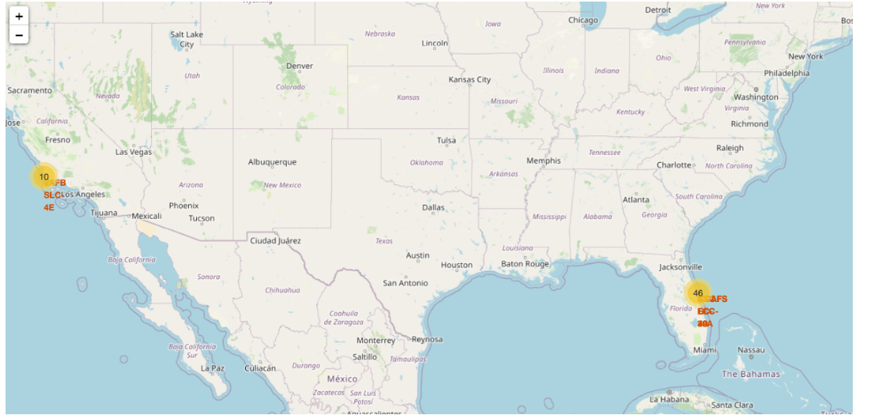
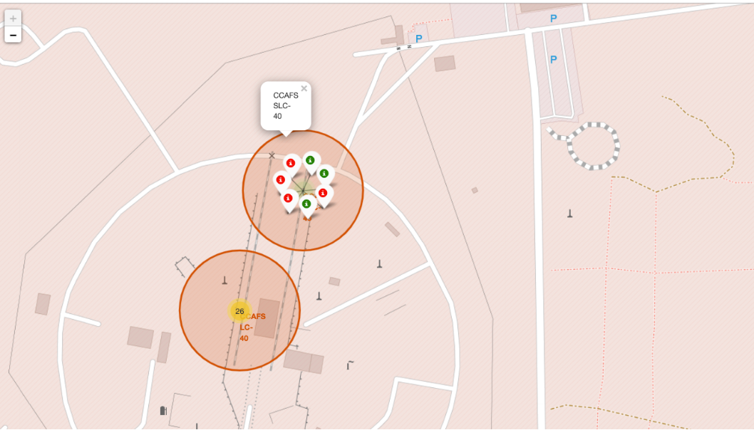
Success/failed launches for each site

Slide 36
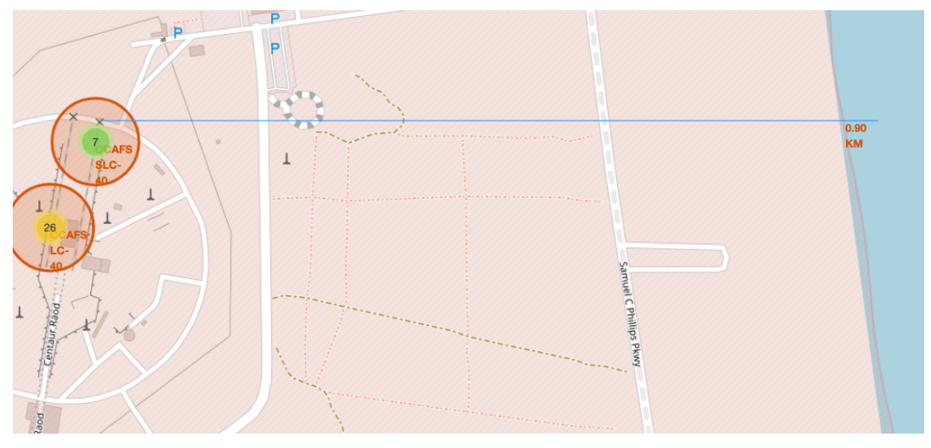
Distances between a launch site to its proximities

Slide 37

Section 4

Slide 38
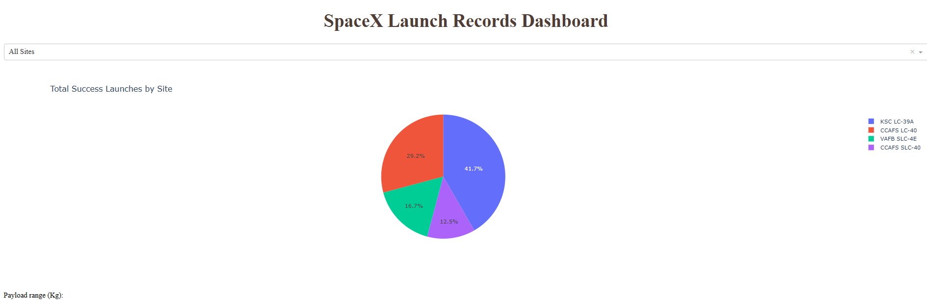
Launch success count for all sites
KSC LC 39A is the best Launch site with the success rate

Slide 39
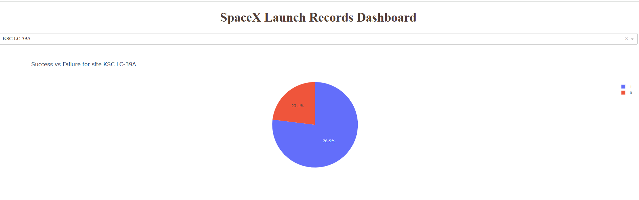
Success vs Failure for site KSC LC 39A
Success rate is 76.9% is the highest of all sites. That means 1 failed over 5 Launch

Slide 40
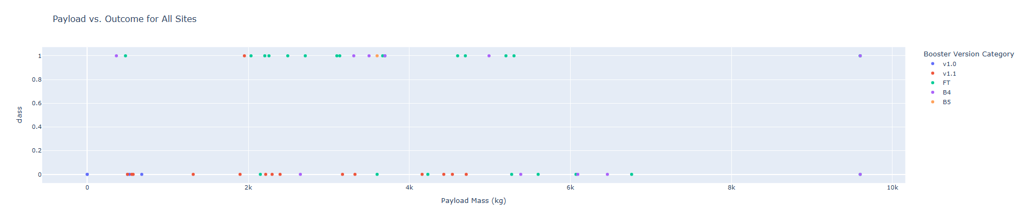
Payload vs. Launch Outcome for all sites

Slide 41

Section 5

Slide 42
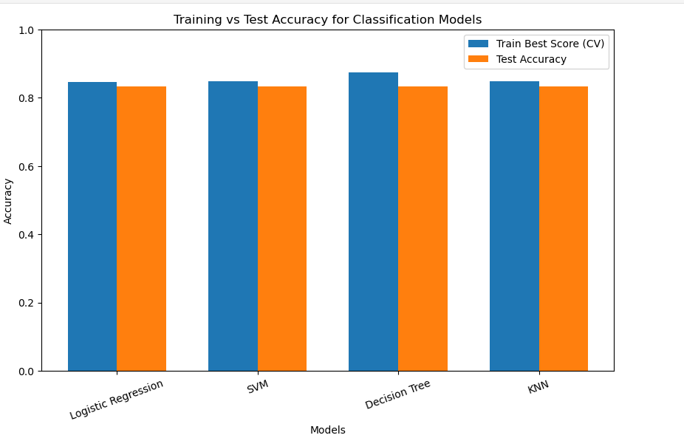
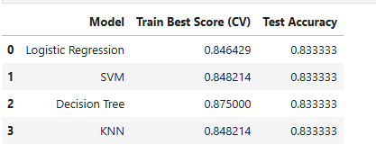
Classification Accuracy
Logistic Regression is the nearest predict score compare train to Test data

Slide 43
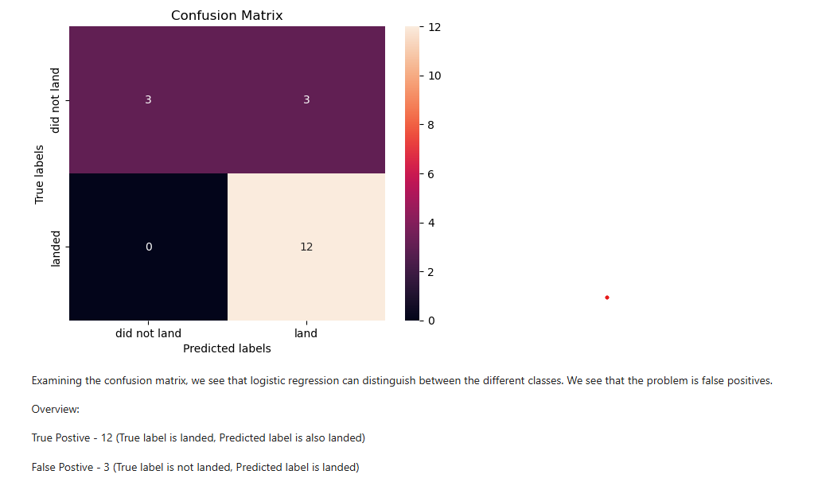
Confusion Matrix
The Best performing model(s) with accuracy 0.8333333333333334: ['Logistic Regression', 'SVM', 'Decision Tree', 'KNN']

Slide 44
Conclusions
Point 1
Point 2
Point 3
Point 4
…

Slide 45
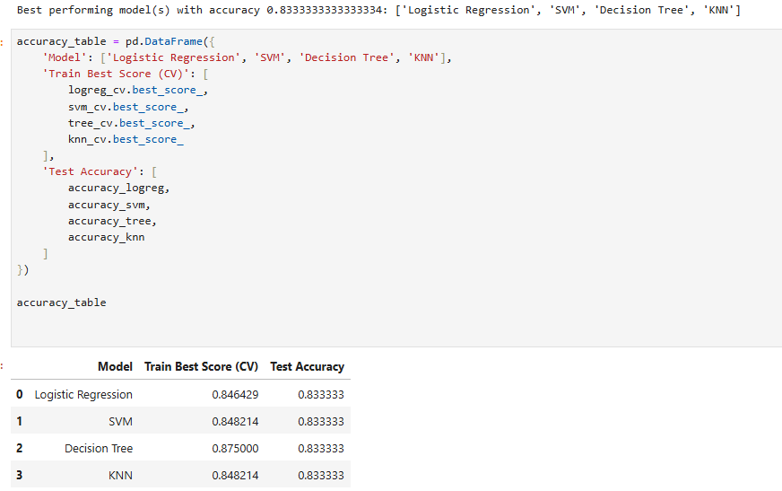
Appendix
Include any relevant assets like Python code snippets, SQL queries, charts, Notebook outputs, or data sets that you may have created during this project

Slide 46


